Slide 1

Context-Aware Behaviour Change Trigger App
Phase 1
By Group-CABCTA 18

Slide 2
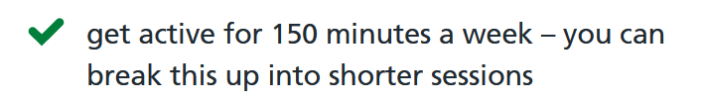
1. User activity- Spark
Context/Sources:
1. User’s lack of movement (Movement/Accelerometer/GPS )
2. User’s step count (Local database)
Prompt:
Pop up notification to tell user to stand up after too much in-activity, also output current step count and remaining goal.
Haptic

Slide 3

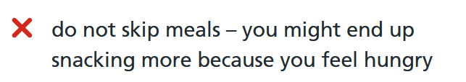
2. Mealtimes- Facilitator
Context/Sources:
1.Time of day(System clock)
2.Current Kcal total from day(local database)
3. Online database of recipes(External API)
Prompt:
Recommend a recipe from online database source tailored to user’s current kcal total
Remind user to not skip the meal, so they don’t lose weight too quickly and also to avoid snacking
Pop-up, haptic feedback and audio(depending on specific meal) to enforce association with particular meal-times.

Slide 4
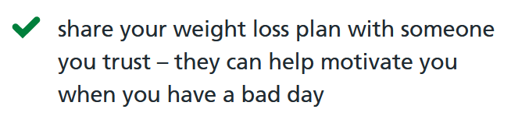
3. Encouragement - Signal
Prompt:
Encouraging message/Notification, i.e clapping noise and vibration to provide stimulating experience for user. Also rewarding positive behaviour and reinforcing good habits.
Context/Sources:
1.Trusted Person/Trainer sends encouraging feedback based on positive perfomance(External API)
2.User’s perfomance/Progress(Local progress database)

Slide 5
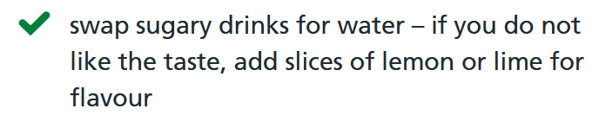
4. Hydration – Signal
Context/Sources:
1.Time of day( System clock)
2. Simple user text input, which totals cups drank in one day (Local database)
Prompt:
Drink Water, lower-fat milks, lower-sugar or sugar-free drinks and tea and coffee all count.
Notify user through popup and audio sound

Slide 6
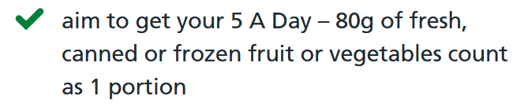
5. 5 A day- Signal
Context/Sources
1.Time of day( System clock)
2. Simple user Input to total fruit/veg eaten in one day (Local database)
Prompt
Current total fruit/veg eaten to show/track progress
Popup - “Eat a portion of fruit of veg to meet your daily 5 a day target” and audio

Slide 7
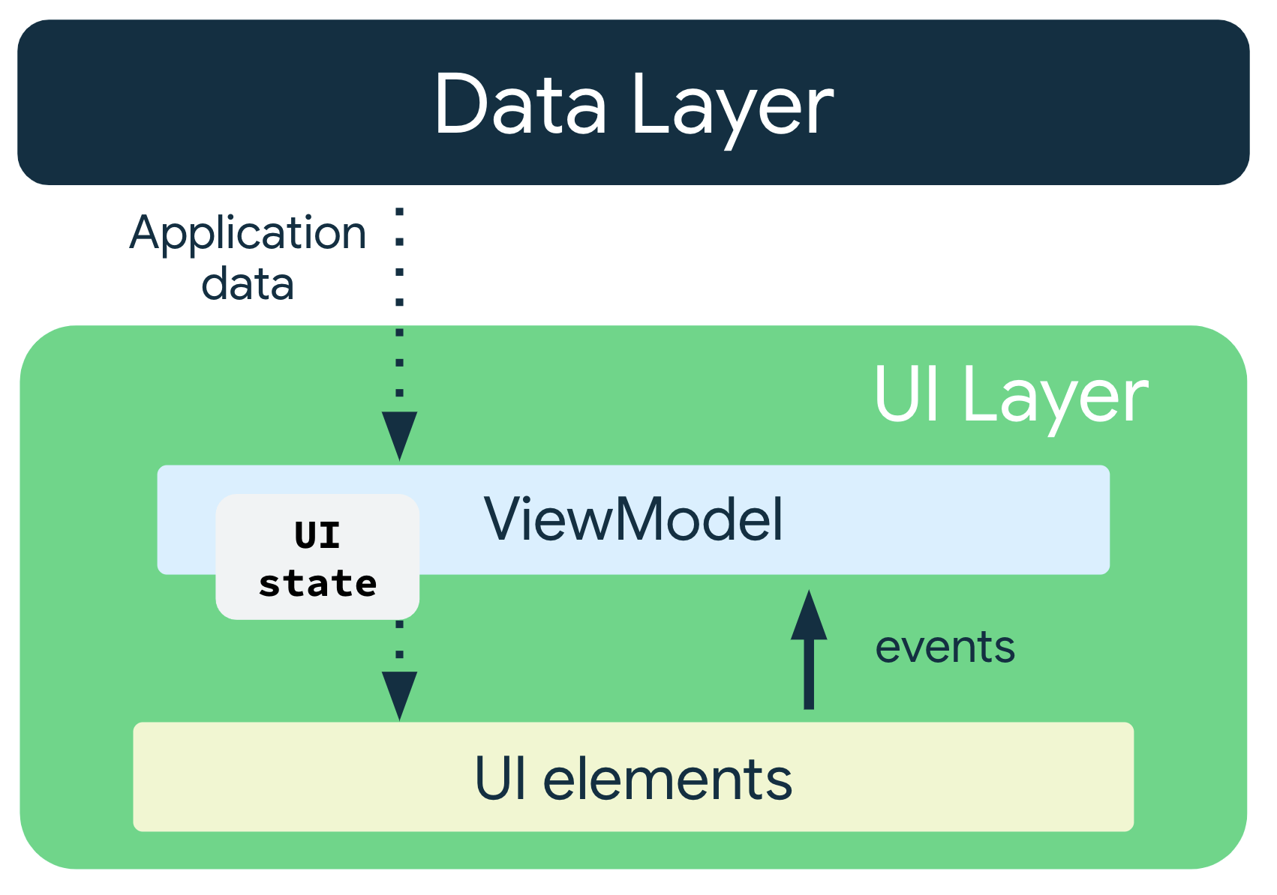
Architecture
App separated into 2 layers; UI layer and Data layer
The UI layer displays application data
The data layer contains business logic of app and exposes application data

Slide 8

Architecture (Cont’)
Context aware trigger app will follow Android standard MVVM architecture
Consists of three main components - Model, view and viewModel
Single source of truth implemented by exposing the data using an immutable type (i.e val), with modification being possible through accessible functions​
Unidirectional data flow ensures low coupling and high cohesion between each component: State flows only in one direction, and events that modify the data flow in the opposite direction.

Slide 9
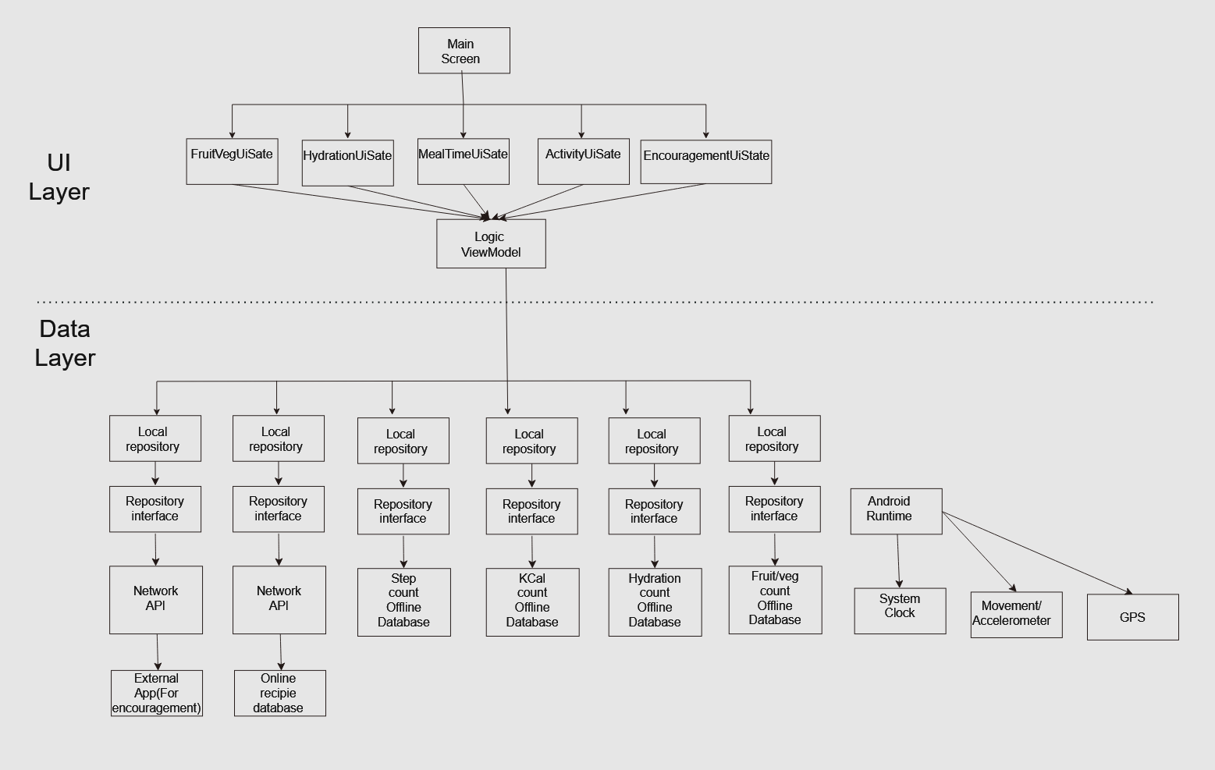
Architecture Layout

Slide 10
References
https://developer.android.com/topic/architecture
https://www.nhs.uk/live-well/healthy-weight/managing-your-weight/tips-to-help-you-lose-weight/
https://www.growthengineering.co.uk/bj-foggs-behavior-model/

Slide 11

Thank you for listening
Any Question?

